Slide 1
Linked Lists
Instructors:
Md Nazrul Islam Mondal &
Rizoan Toufiq
Department of Computer Science & Engineering
Rajshahi University of Engineering & Technology Rajshahi-6204

Slide 2
Outline
Introduction
Linked List
Representation of Linked Lists in Memory
Traversing a Linked List
Searching a Linked List
Memory Allocation; Garbage Collection
Insertion into a Linked List
Deletion from a Linked List
Header Linked List
Two Way Lists
Arrays, Records and Pointers

Slide 3
Deletion from a Linked List
Arrays, Records and Pointers

Slide 4
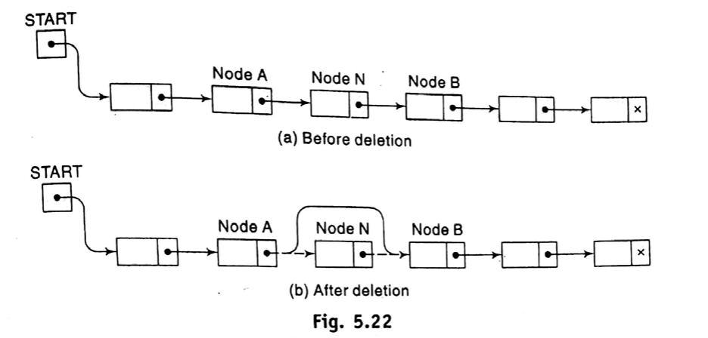
Deletion from a Linked List
Arrays, Records and Pointers

Slide 5
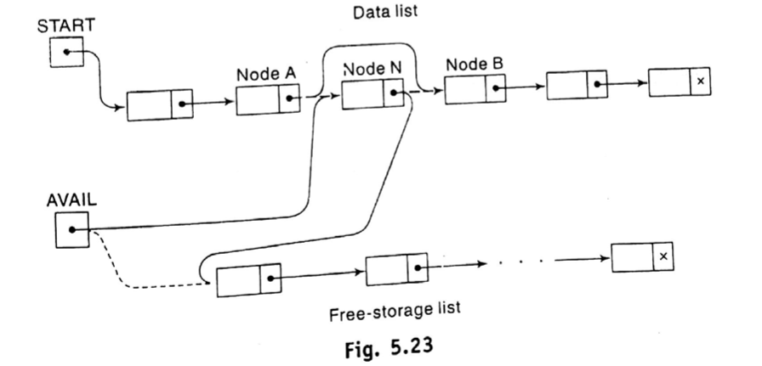
Deletion from a Linked List
Three Pointer fields are changed as follows:
Arrays, Records and Pointers

Slide 6
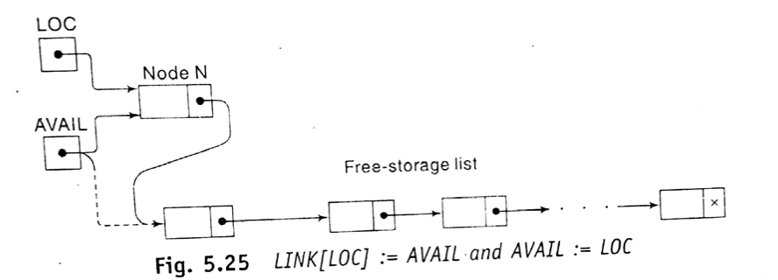
Deletion from a Linked List
Add deleted node with available list
LINK[LOC]←AVAIL
AVAIL ← LOC
Arrays, Records and Pointers

Slide 7
Deletion from a Linked List
Preceding Node of Node N
Node A |  |  | Node N
 |  |  |  |  |  |  |  | … |  | x
Arrays, Records and Pointers

Slide 8
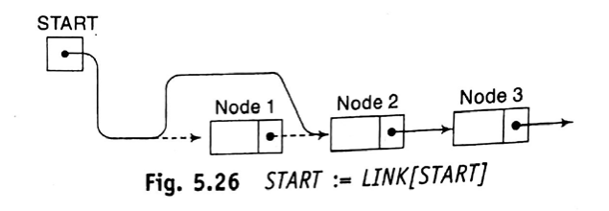
Deletion from a Linked List
(Deleting the Node following a Given Node)
Case 1: Delete first node
START←LINK[START]
Arrays, Records and Pointers

Slide 9
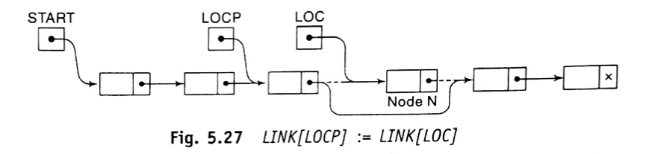
Deletion from a Linked List
(Deleting the Node following a Given Node)
Case 2: Delete other node
LINK[LOCP]←LINK[LOC]
Arrays, Records and Pointers

Slide 10
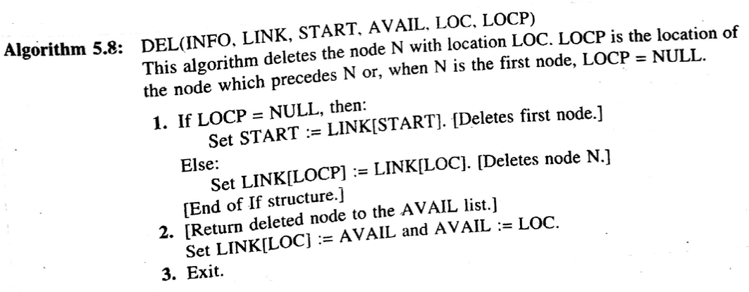
Deletion from a Linked List
(Deleting the Node following a Given Node)
Arrays, Records and Pointers

Slide 11
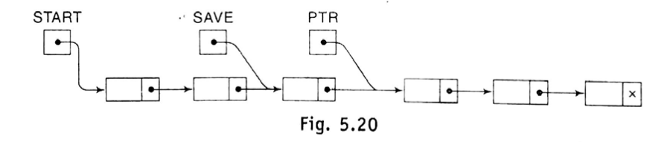
Deletion from a Linked List
(Deleting the Node with a Given ITEM of Information)
Step1: Search the item i.e. FINDB()
SAVE:=PTR
PTR:=LINK[PTR]
Arrays, Records and Pointers

Slide 12
Deletion from a Linked List
(Deleting the Node with a Given ITEM of Information)
Output of the searching algorithm:
  Case – 1: LIST is NULL, LOC:=NULL,LOCP:=NULL
  Case – 2: ITEM in FIRST Node, LOC:=START, LOCP:=NULL
  Case – 3: ITEM in Other Node, LOC:=PTR, LOCP:=SAVE
  Case – 4: ITEM is not in LIST, LOC:=NULL, LOCP:=NULL
Step2: Perform Delete Operation i.e. DELETE()
Arrays, Records and Pointers

Slide 13
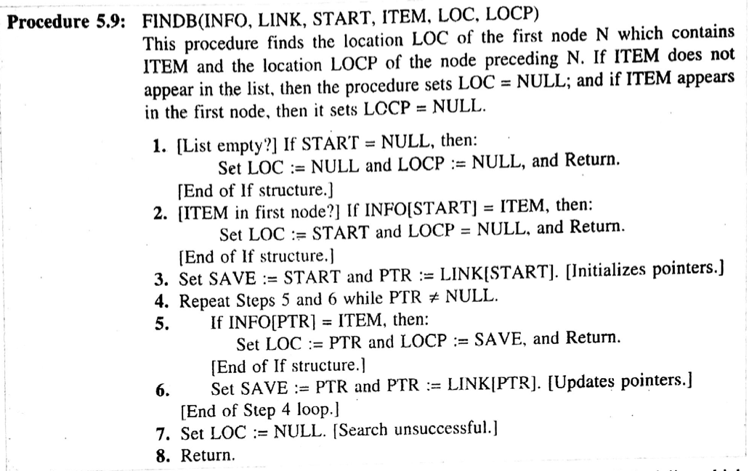
Deletion from a Linked List
(Deleting the Node with a Given ITEM of Information)
Arrays, Records and Pointers

Slide 14
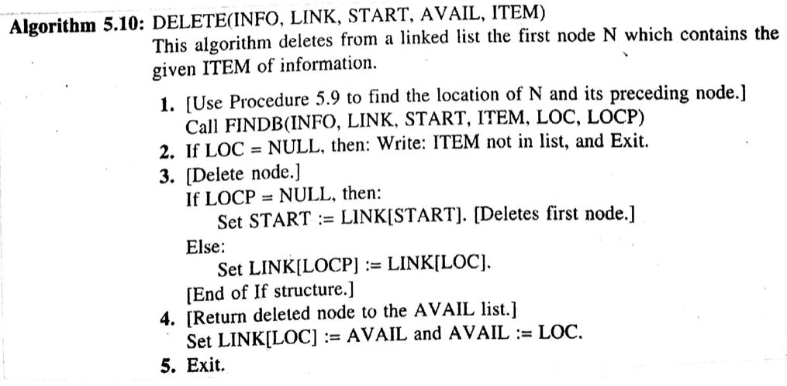
Deletion from a Linked List
(Deleting the Node with a Given ITEM of Information)
Arrays, Records and Pointers

Slide 15
Deletion from a Linked List
Source Code
Arrays, Records and Pointers

Slide 16
END
Arrays, Records and Pointers

